Slide 1
Virtualization and
Computer Architecture

Slide 2
Agenda
What is Virtualization?
Platforms
VERY brief overview of Computer Architecture

Slide 3

What is Virtualization?
What do you think it is?

Slide 4
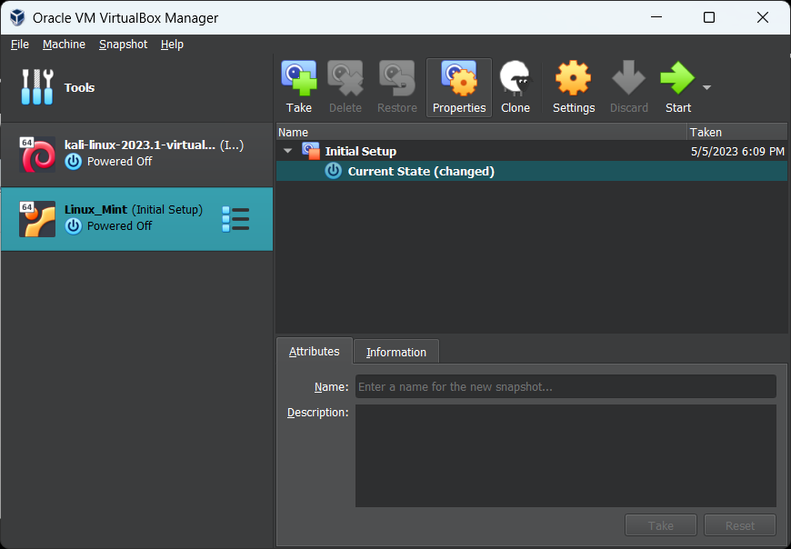

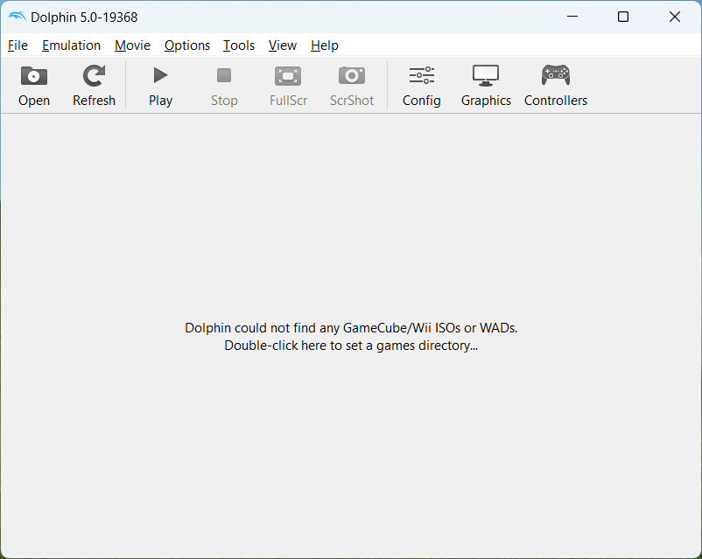
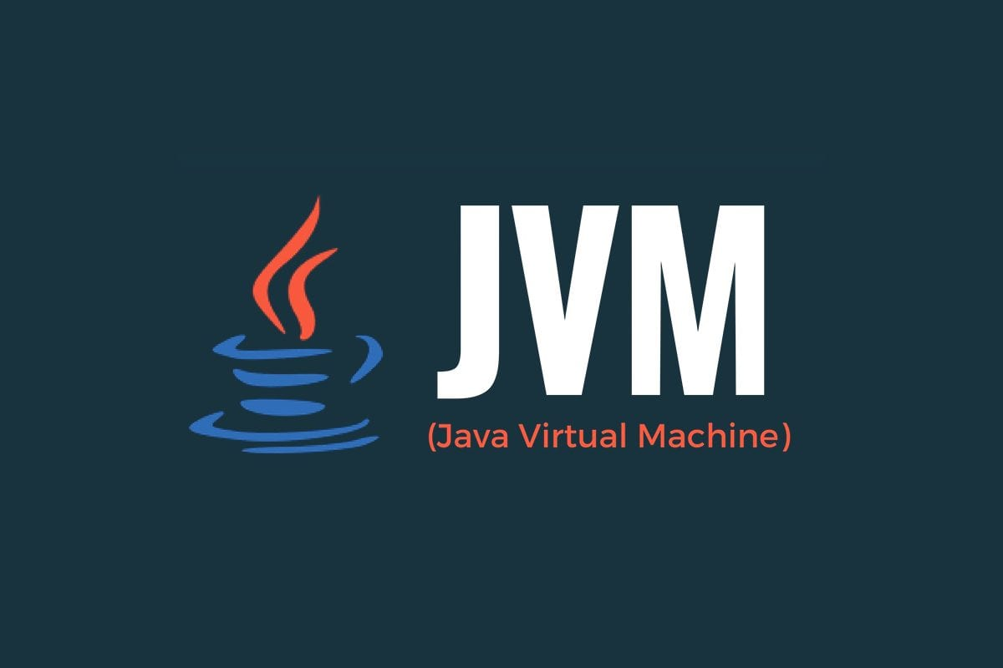

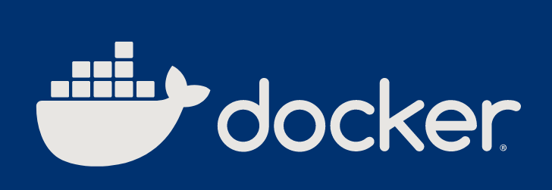
Virtualization
Simulating hardware using software on other hardware.

Slide 5
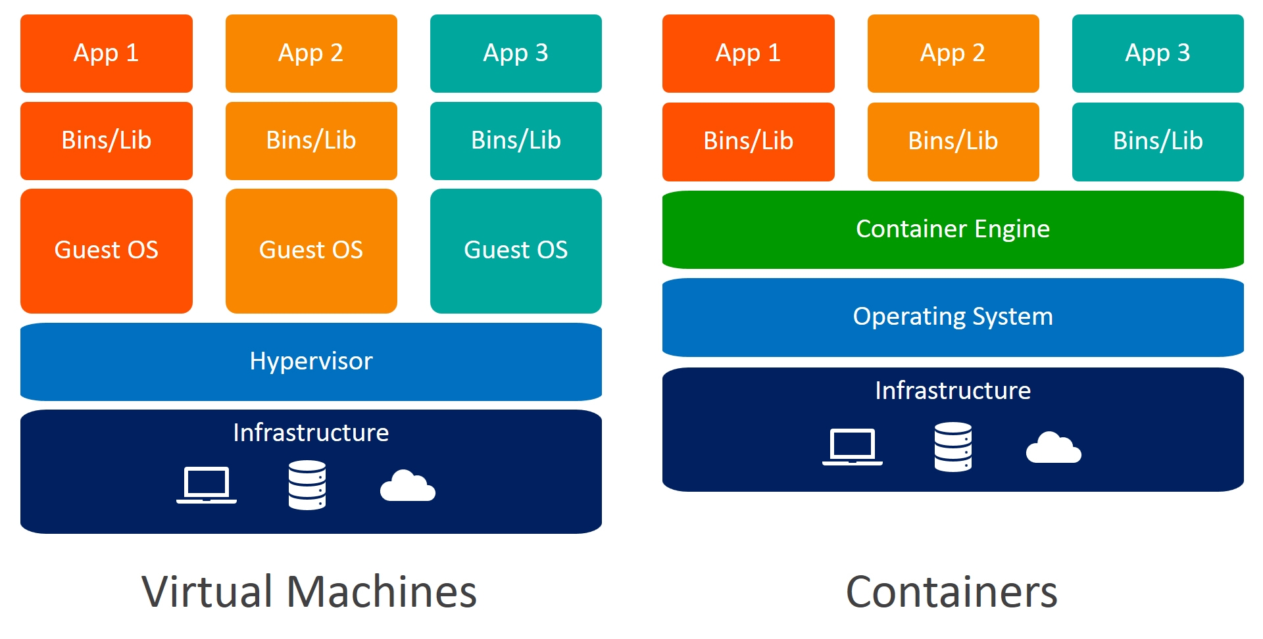
Traditional VMs and Containers
https://raw.githubusercontent.com/dazzyddos/dazzyddos.github.io/master/Images/DockerBuildSec/vmvsdocker.jpg

Slide 6
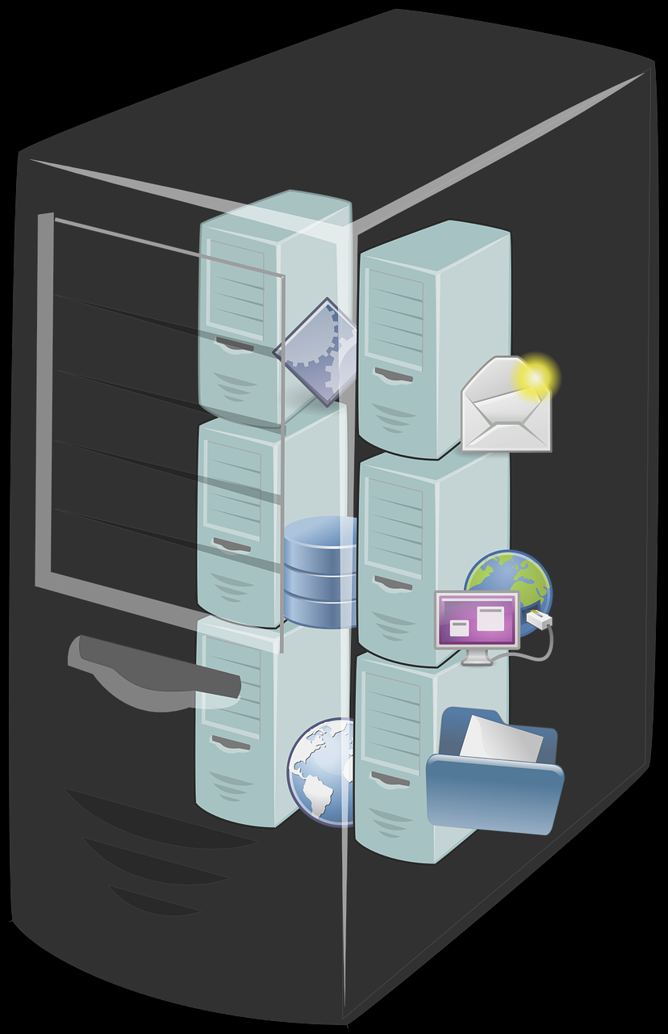
Platforms
VMWare
VirtualBox
Windows Subsystem for Linux (WSL)
Amazon Web Services (AWS)
  Vocareum
Azure (Microsoft)
Docker

Slide 7

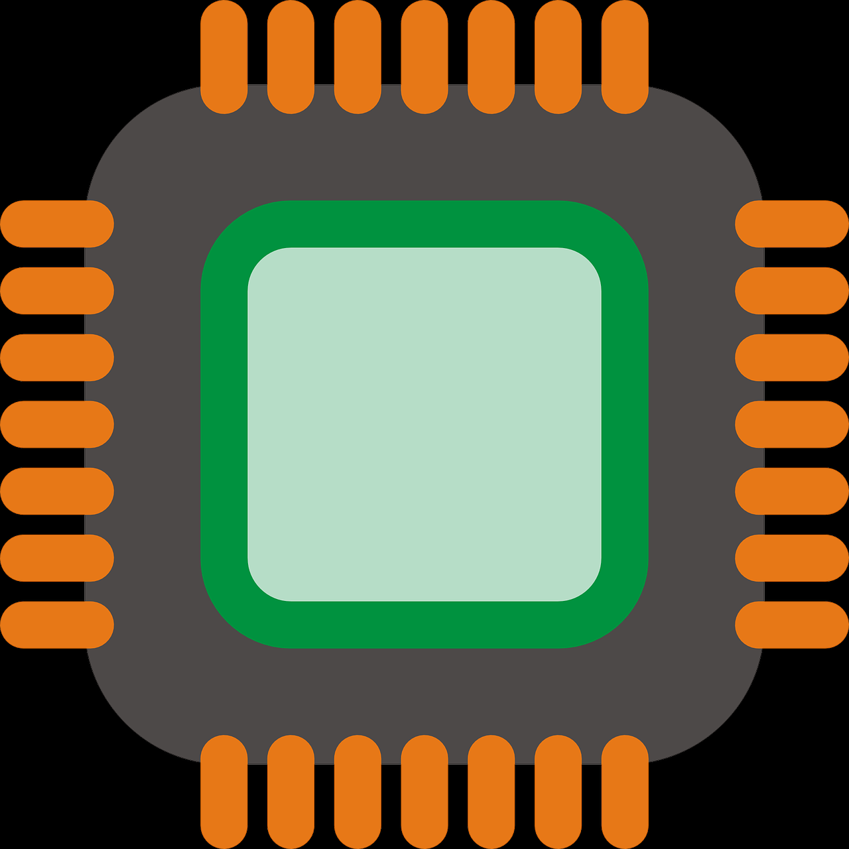
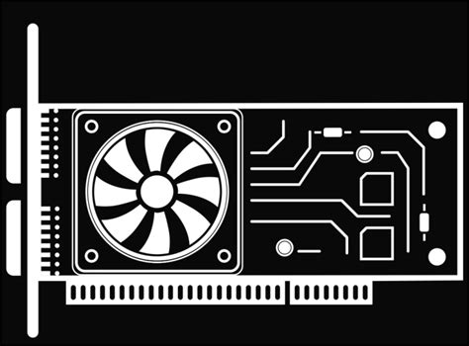
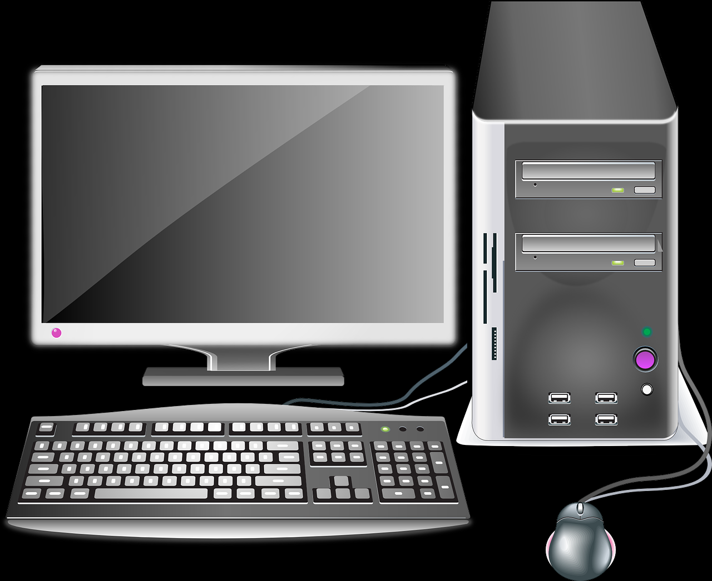
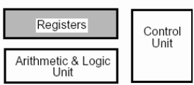
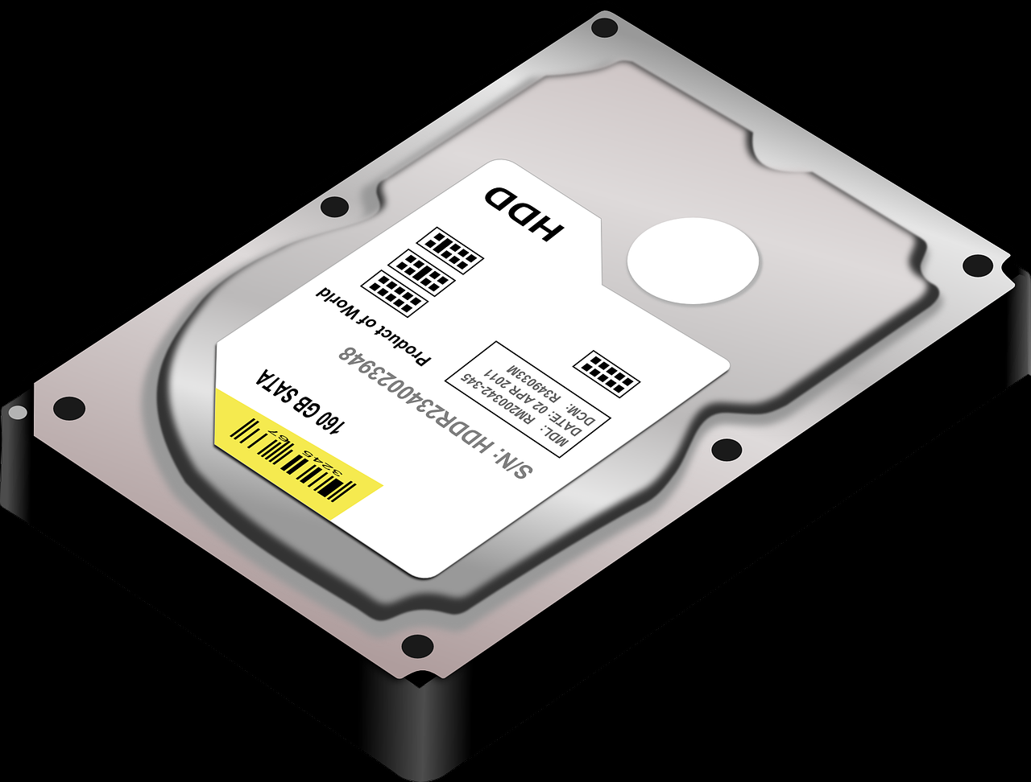
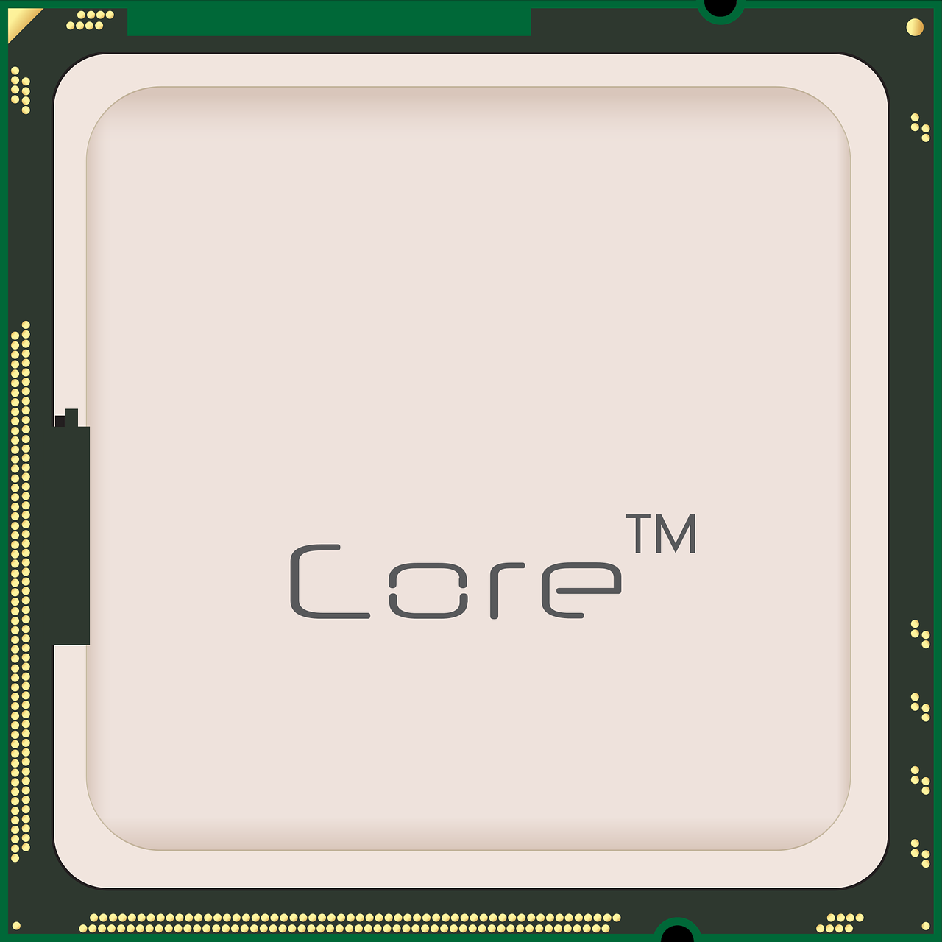
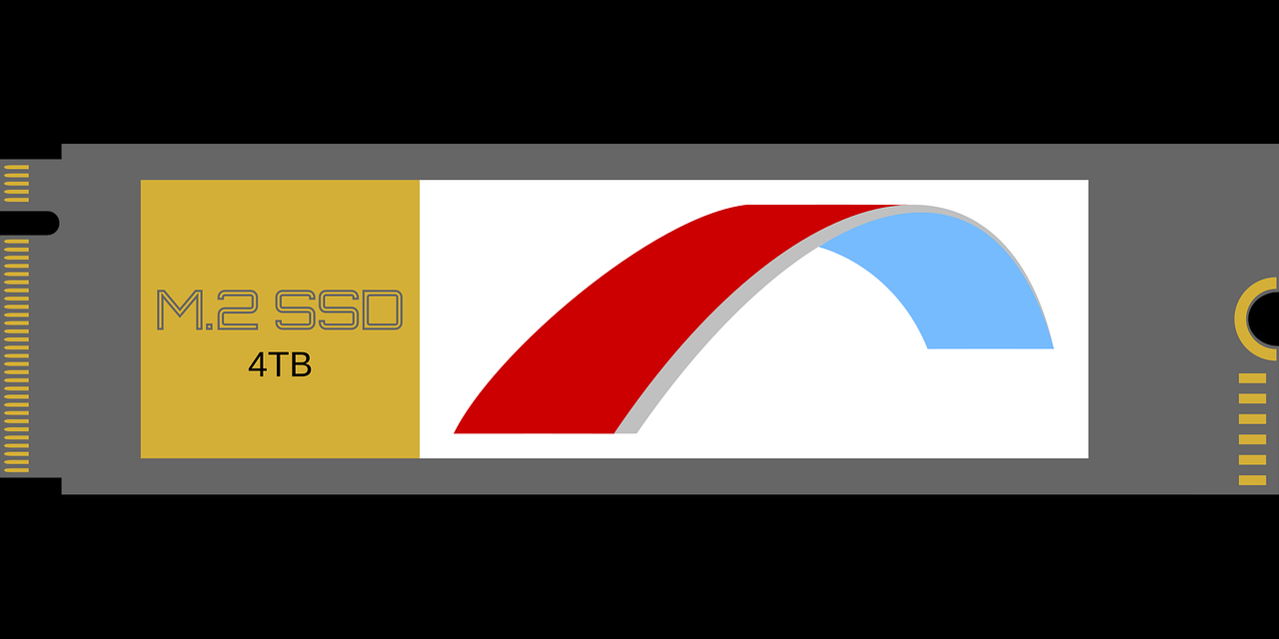
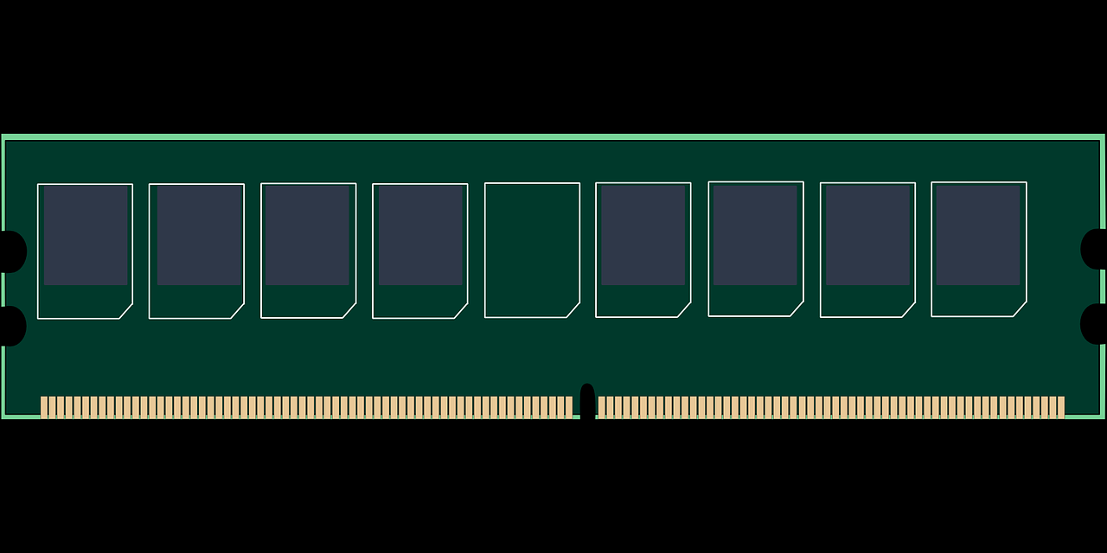
Computer Architecture
10
10

Slide 8
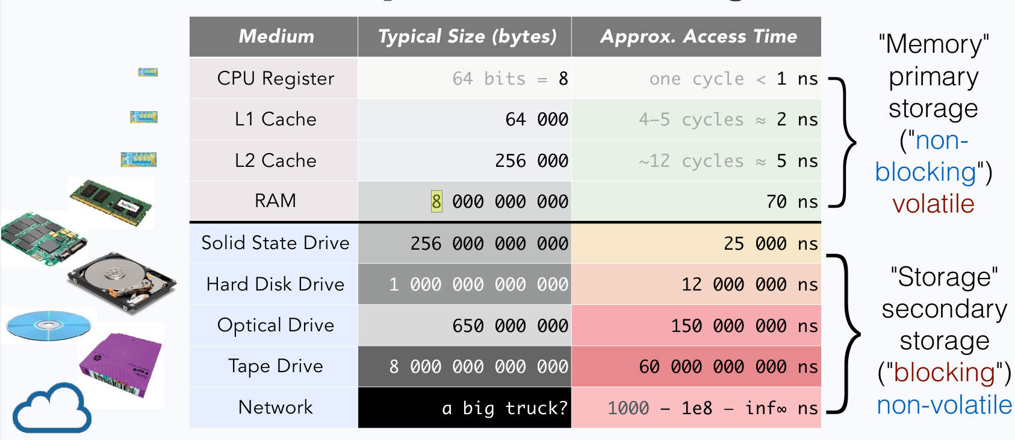
Computer Architecture

Slide 9
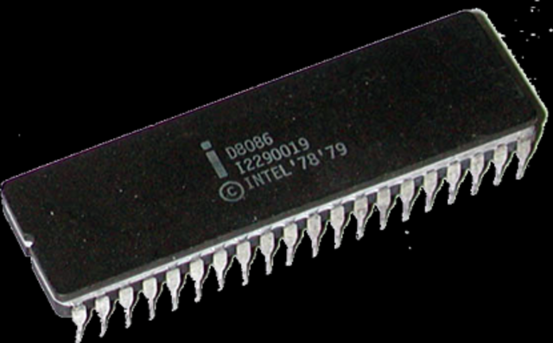
x86/x64 Vs ARM
Apple’s M1 and M2 chips run ARM
x86 – 32bit Intel Architecture
  Named for the 8086 CPU
X64 – 64bit Intel Architecture
  Named for the size of the CPU registers…
  Actually makes sense.

Slide 10
x86/x64 Vs ARM
ARM
  Newer
  Smaller instruction set
  Primarily used in mobile devices
x86/x64
  Legacy
  Instruction set designed to be backwards compatible
  The goto CPU architecture for decades

Slide 11
x86/x64/ARM and Virtualization
The key is the instruction sets
The language of the CPU
Since x86/x64 has a larger dictionary than ARM you cannot translate 1 to 1 between the two
Efforts have/are being made to visualize x86/x64 software on ARM architecture
Sera’s recommendation is to use a x64 machine for virtualization generally.

Slide 12
x86 Vs x64
x86 architecture finished its run with 32bit registers. The 8086 itself had 16 bit registers.
x64 architecture uses… [pause for dramatic effect] 64bit registers!
X64 platforms can run in x86 mode
X86 platforms can NOT run in x64 mode; they simply do not have registers big enough

Slide 13
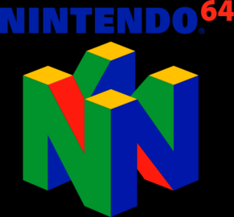
N64
The Nintendo 64 was called that because it featured a 64 bit processor!
Most games did not actually utilize this fact ¯\_ (ツ)_/¯
This “N” logo has 64 faces; a reference to the 64 bit architecture

